Slide 1
Choosing Temporal deconvolution parameter of CNMF-E
02/14/2021

Slide 2
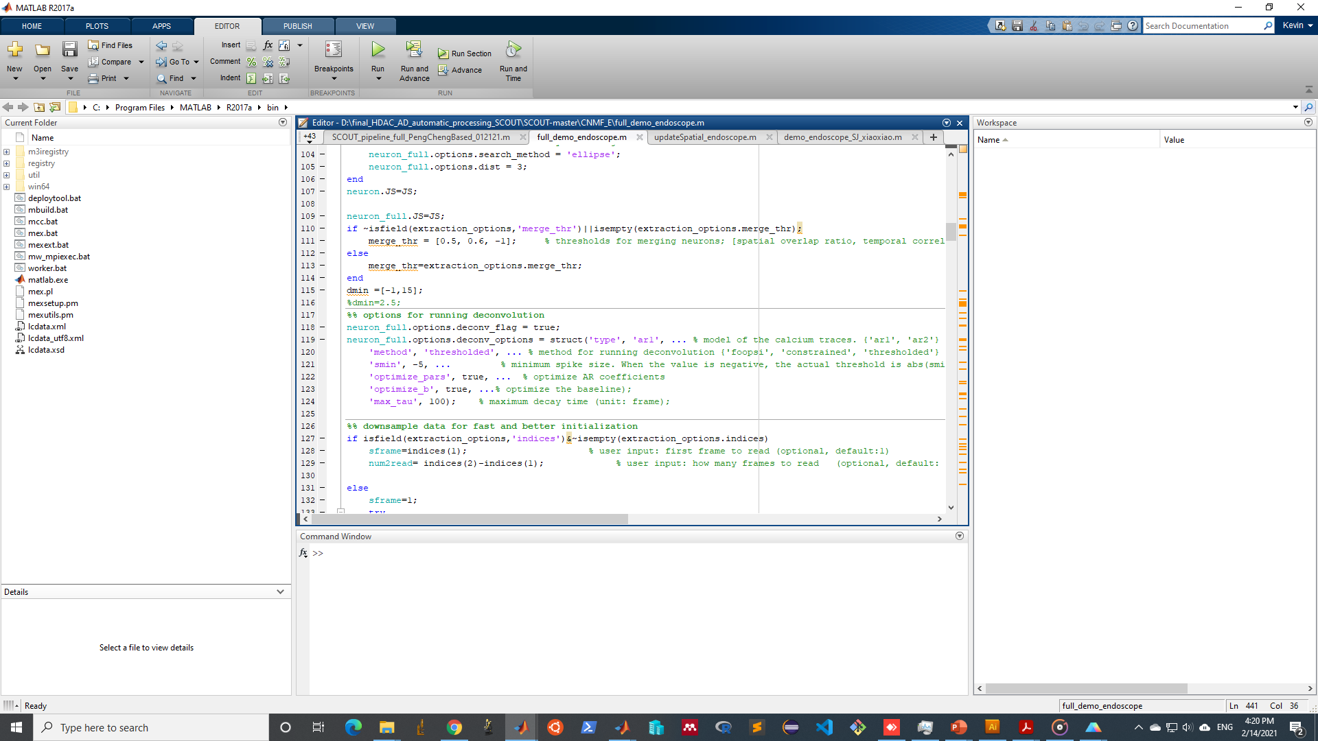
The deconvolution parameters
CNMF-E offers 3 options to extract neuron.C:
FOOPSI: original fast nonnegative deconvolution algorithm (Vogelstein et al.2010)
Constrained: constrained FOOPSI that automatically choose the AR model parameter (Pnevmatikakis et al.2016)
Thresholded: Thresholded constrained FOOPSI that have an amplitude height threshold to trim false positive spikes (Friedrich et al. 2017)
“Thresholded” represents the most upgraded FOOPSI method, should be preferred during extraction

Slide 3
FOOPSI and thresholded: compared with raw trace

